Slide 1
Ethics 2021 Carla Miller, Ethics Director

Slide 2
2019
ETHICS

Slide 3
1980-2021

Slide 4
2019-2021
Sale of JEA
Covid

Slide 5
Lessons Learned? Words of Wisdom?
COJ Ethics Training 1999-2021

Slide 6
5

Slide 7
1.

Slide 8
1. Culture wins Over Rules
Culture: shared assumptions about how to adapt and survive

Slide 9
JEA Culture Survey

Slide 10
Winning Survey Response!

Slide 11
JEA and the Citizens
“I want to be here for more than my pay.
I want to be part of building my community, not selling them out.”

Slide 12
Threats and Stress

Slide 13
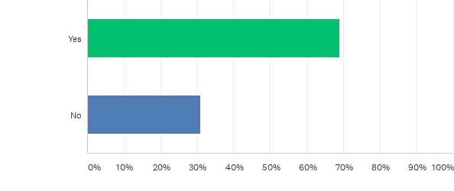
Q1: During the Invitation to Negotiate (ITN) process, did you have any clues something was not right at JEA? (CLUES ARE ALL YOU HAVE INITIALLY….)

Slide 14
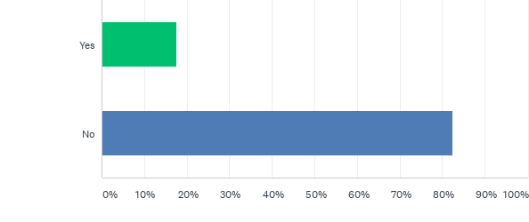
Q4: Did you feel like there was a safe way to report concerns during the ITN process?

Slide 15
Key Question
Are you proud to be a JEA employee? 87% YES

Slide 16
How do you know if you are in an “ETHICAL CULTURE”?

Slide 17
Ethical Culture
Truthful
Transparency
Respect and empathy for people
Fairness
Safe to raise problems/concerns
No hidden agendas
Promises kept (bonuses)
High morale/retention
Growth of staff encouraged—people are happy

Slide 18
Unethical Culture
Fear
Threats
Insecurity - concern for job
Punished for voicing concerns - must not question
Aggressive management
No one to trust
Lack of transparency - people muzzled
Stress - people not happy

Slide 19
Culture wins Over Rules
Law and Rules are important,
Culture is more important.

Slide 20
What is the “Culture” as to Ethics?

Slide 21
2.

Slide 22
2. Ethics is the key to Culture Development

Slide 23
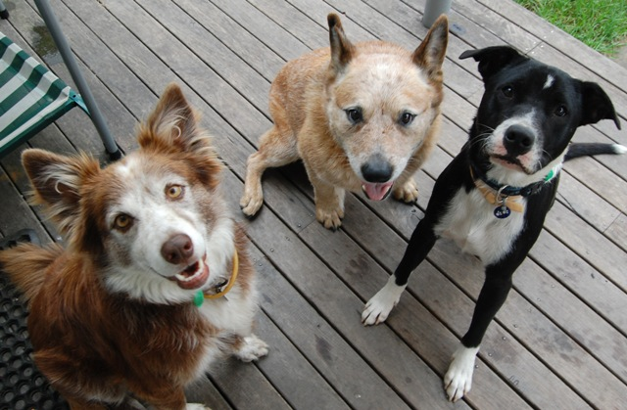
THE “THREE DOG THEORY OF ETHICS”
Notes:
23

Slide 24
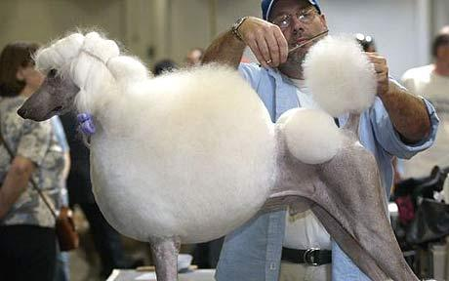
1. The LAPDOG

Slide 25
2. The ATTACK DOG

Slide 26
The “Gotcha” System

Slide 27
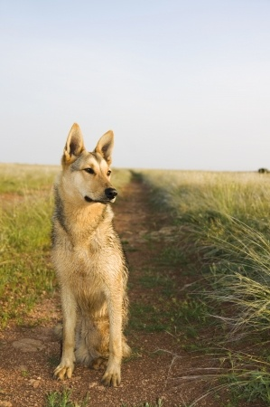
3. The WATCHDOG

Slide 28
Role of Watchdog….
Training
Compliance with the Law
Advice
*ASSESSMENT AND DEVELOPMENT OF AN ETHICAL CULTURE

Slide 29
How Is This Ethics?
Ethics is not just following rules and checking boxes.
It is how happy you are at work, if you feel valued and safe.
Corruption and Ethics risks go up if culture is stressed.

Slide 30
GOAL OF ETHICS OFFICE:
LEARN FROM NATIONAL BEST PRACTICES AS TO HOW TO DEVELOP AN ETHICAL CULTURE
EARLY WARNING SYSTEM…..

Slide 31
3.

Slide 32
Optimist or Pessimist?

Slide 33
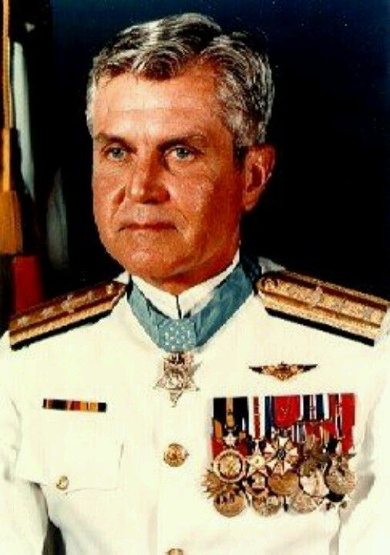
Stockdale Paradox

Slide 34
Stockdale Paradox
Three Choices:
1. OPTIMISM—No problem here, all is OK; it’s over now… (under-reacting)
2. PESSIMISM—We’re doomed…. (over-reacting)
3. MIDDLE GROUND: A belief in eventual success with a deep acceptance of the harsh current reality “confronting brutal facts”

Slide 35
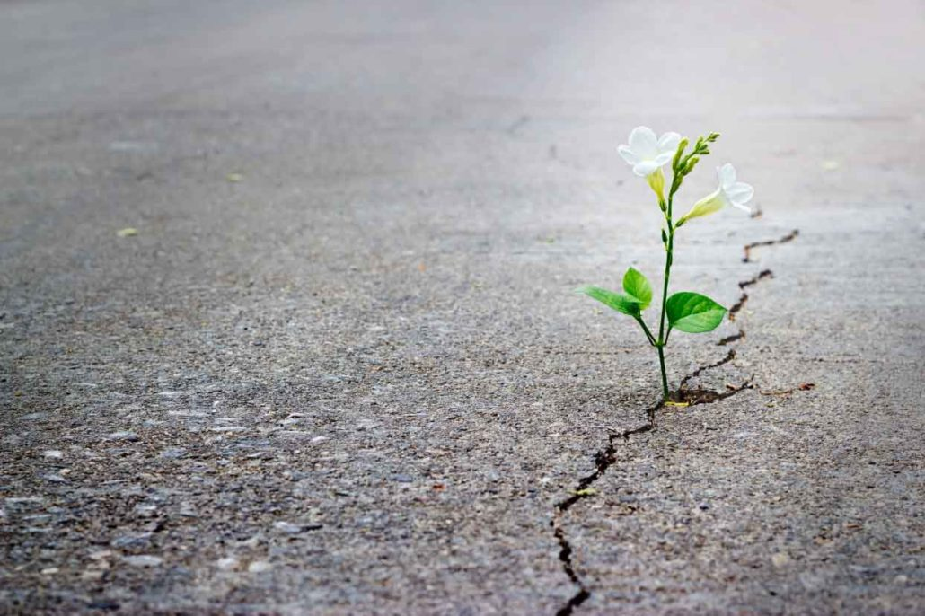
HOPE

Slide 36
Hope Can Be Measured The “hope test” And hope can be increased…

Slide 38
4.

Slide 39
Authenticity

Slide 40
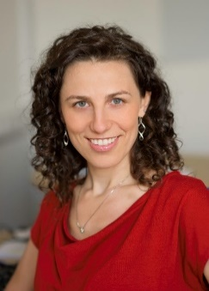
People are more engaged and satisfied with their work, performed their tasks more effectively, and were less likely to quit when there was a focus on their strengths.
If you allow people to talk about “who” they are, and “why” they are doing what they are doing….
6 times more likely to be engaged in their work; 3 times more likely to say they have an excellent quality of life.
Dr. Francisco Gino, Harvard

Slide 41
THINK OF YOUR TOP STRENGTH

Slide 42
WHAT ARE YOUR STRENGTHS?
Gallup Strength Test
Play to your strengths

Slide 43
5.

Slide 44
PURPOSE
WHAT IS YOUR WHY –YOUR PURPOSE (Sinek TED talk)

Slide 45
Win by being the “Man” in the Arena…. Teddy Roosevelt
“It is not the critic who counts; not the man who points out how the strong man stumbles, or where the doer of deeds could have done them better. The credit belongs to the man who is actually in the arena, whose face is marred by dust and sweat and blood; who strives valiantly; who errs, who comes up short again and again, …..
but who …spends himself in a worthy cause; who at the best knows in the end the triumph of high achievement, and who at the worst, if he fails, at least fails while daring greatly, so that his place shall never be with those cold and timid souls who neither know victory nor defeat.”

Slide 46
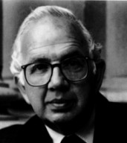
“Our souls are not hungry for fame, comfort, wealth or power. Our souls are hungry for meaning, for the sense that we have figured out how to live so that our lives matter, so that the world will be at least a little bit different for our having passed through it.”
Rabbi Harold Kushner

